Slide 1
Electric Fields and Gauss’s Law

Slide 2
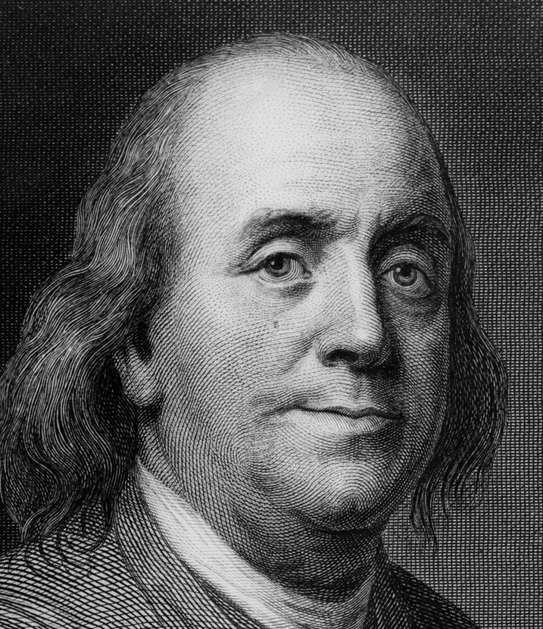
Properties of Electric Charges
Two types of charges exist (named by Benjamin Franklin): positive and negative
Like charges repel and unlike charges attract one another
Nature’s most basic positive charges are the protons (held firmly in the nucleus and do not move from one material to another)
Nature’s most basic negative charges charge are the electrons – an object becomes charged by gaining or losing electrons
Benjamin Franklin 1706 – 1790

Slide 3
Insulators and Conductors
Conductor: A material whose conduction electrons are free to move throughout. Most metals are conductors.
Insulator: A material whose electrons seldom move from atom to atom. Most insulators are non-metals.

Slide 4
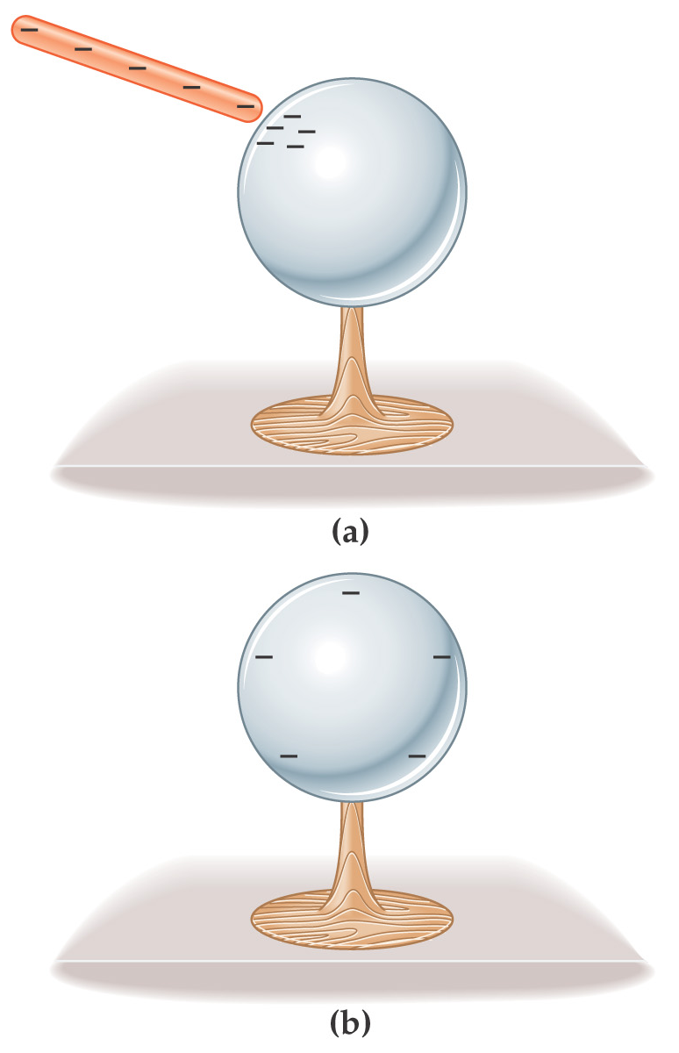
Insulators and Conductors
If a conductor carries excess charge, the excess is distributed over the surface of the conductor.

Slide 5
Insulators and Conductors
Semiconductors have properties intermediate between conductors and insulators; their properties change with their chemical composition.
Photoconductive materials become conductors when light shines on them.

Slide 6
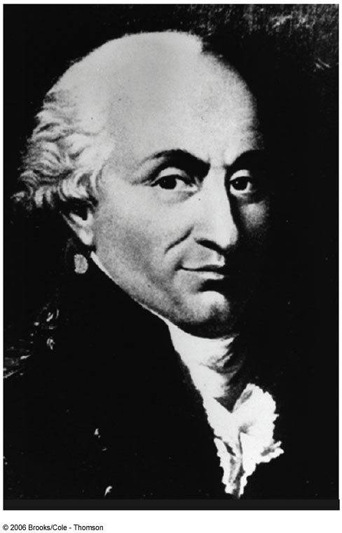
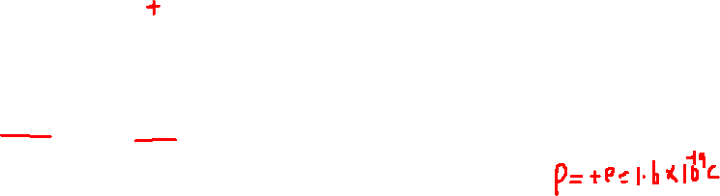
Properties of Electric Charges
Electric charge is always conserved (not created, only exchanged)
Objects become charged because negative charge (electrons) is transferred from one object to another.
The charge of the proton is e and that of the electron -e is where e is called the fundamental unit of charge.
The charge of an electron or proton is an intrinsic property of the particle, just as mass and spin are intrinsic properties of these particles.
The SI unit of charge is the Coulomb (C)
e = 1.6 x 10⁻¹⁹ C
Charles Coulomb 1736 – 1806

Slide 7
Quantization of Electric Charges
The electric charge, q, is said to be quantized.
q is the standard symbol used for charge as a variable.
Electric charge exists as discrete packets.
q = ±Ne
N is an integer
e is the fundamental unit of charge
|e| = 1.6 x 10⁻¹⁹ C
Electron: q = -e
Proton: q = +e
To give an everyday example of charging a plastic rod by rubbing it with a piece of fur typically transfers 10¹⁰ or more electrons to the rod
Section 23.1

Slide 8
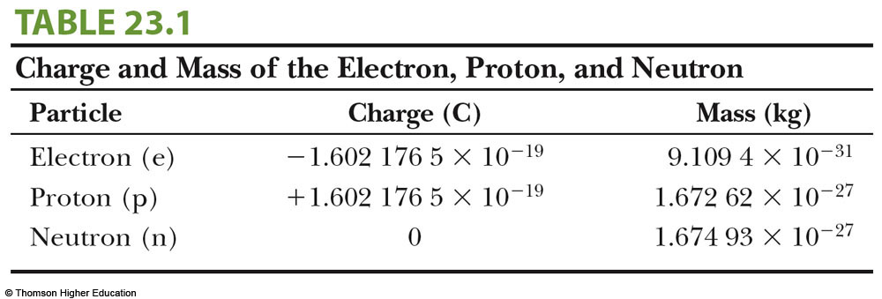
Particle Summary

Slide 9
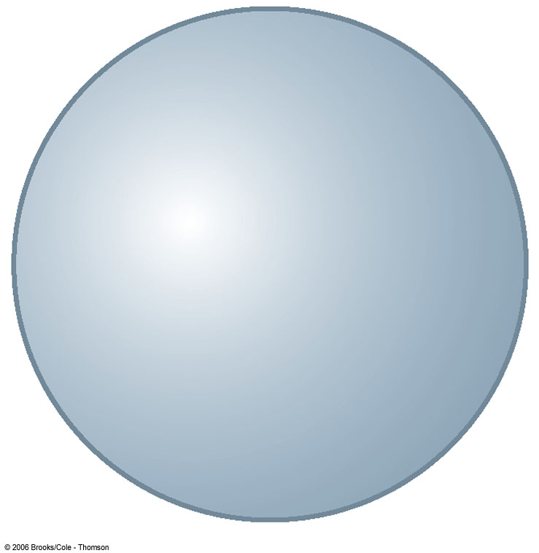
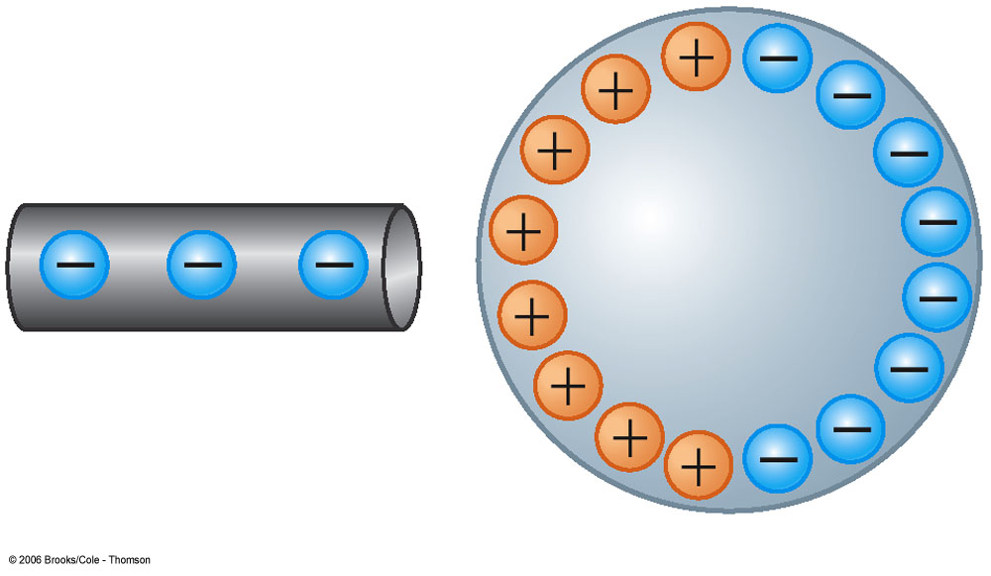
Charging by Induction
A negatively charged rubber rod is brought near an uncharged sphere
The charges in the sphere are redistributed (some of the electrons in the sphere are repelled from the electrons in the rod)
The region of the sphere nearest the negatively charged rod has an excess of positive charge because of the migration of electrons away from this location

Slide 10
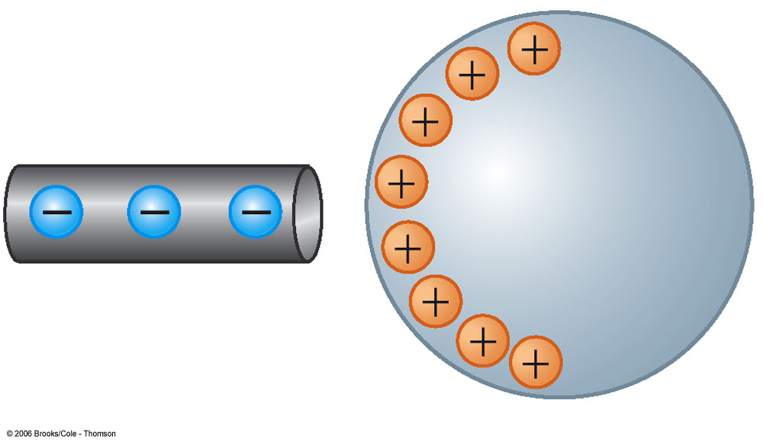

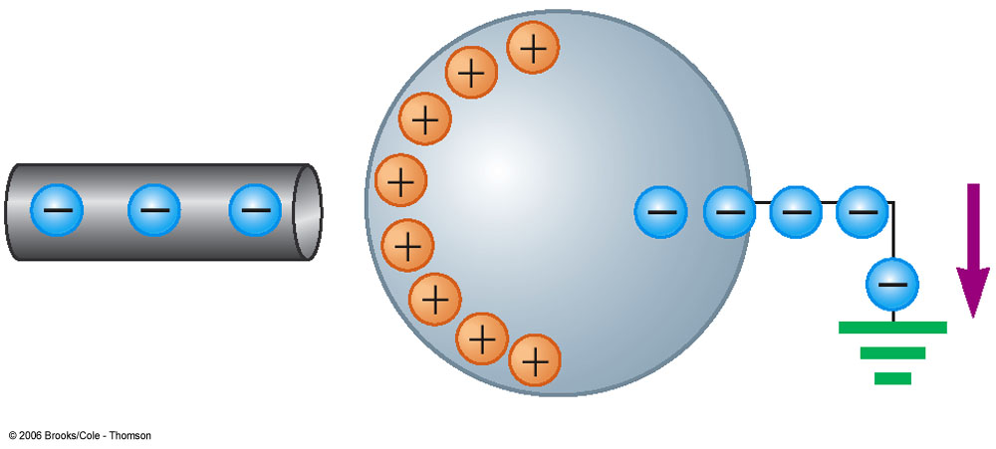
Charging by Induction
When an object is connected to a conducting wire or pipe buried in the earth, it is said to be grounded
A grounded conducting wire is connected to the sphere and allows some of the electrons to move from the sphere to the ground
The wire to ground is removed and the sphere is left with an excess of induced positive charge

Slide 11
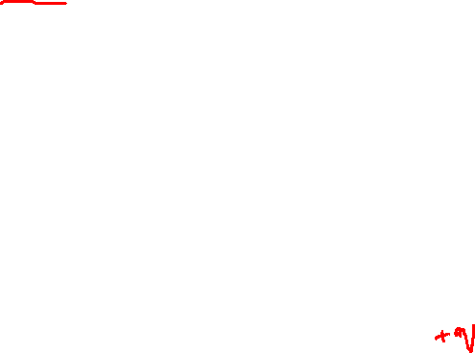
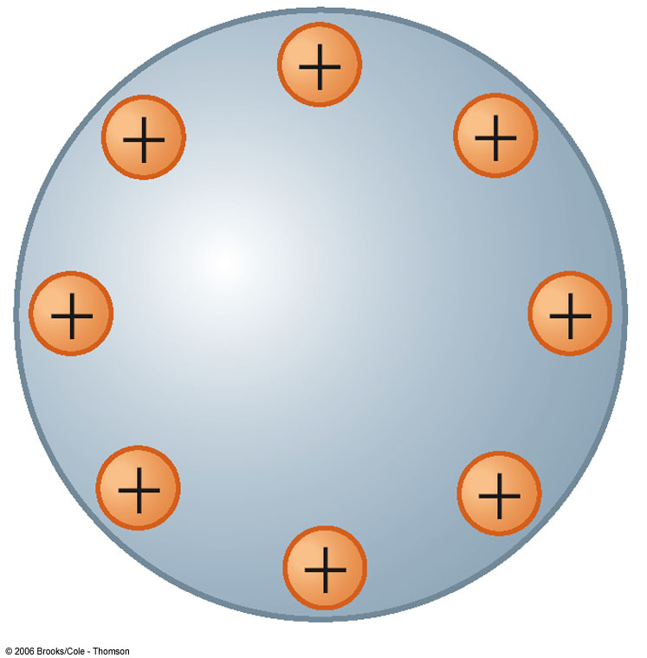
Charging by Induction
The positive charge on the sphere is evenly distributed due to the repulsion between the positive charges
Charging by induction requires no contact with the object inducing the charge

Slide 12
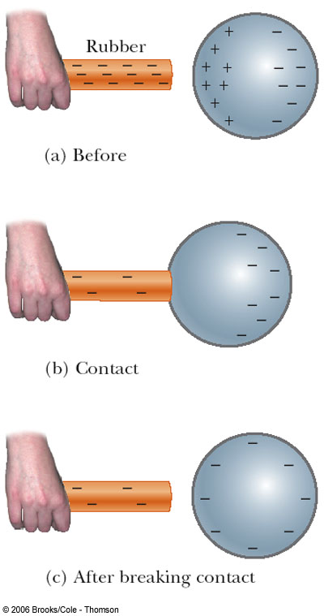
Charging by Conduction
A charged object (the rod) is placed in contact with another object (the sphere)
Some electrons on the rod can move to the sphere
When the rod is removed, the sphere is left with a charge
The object being charged is always left with a charge having the same sign as the object doing the charging

Slide 13
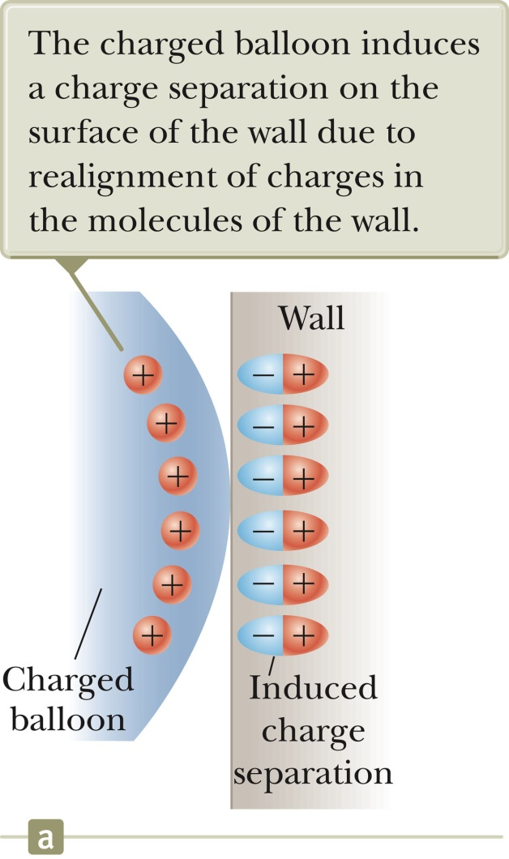
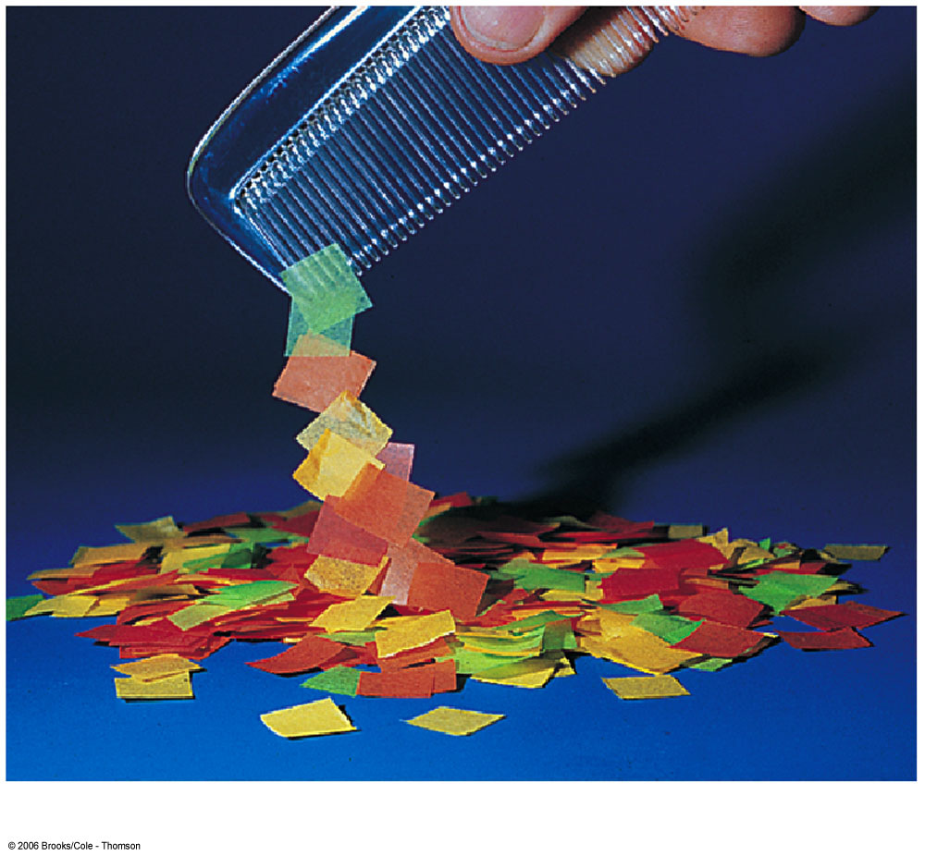
Charge Rearrangement in Insulators (Polarization)
A process similar to induction can take place in insulators.
The charges within the molecules of the material are rearranged.
The proximity of the positive charges on the surface of the object and the negative charges on the surface of the insulator results in an attractive force between the object and the insulator.
Section 23.2

Slide 14
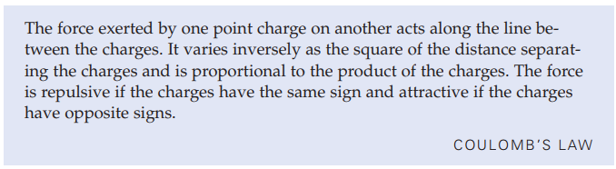
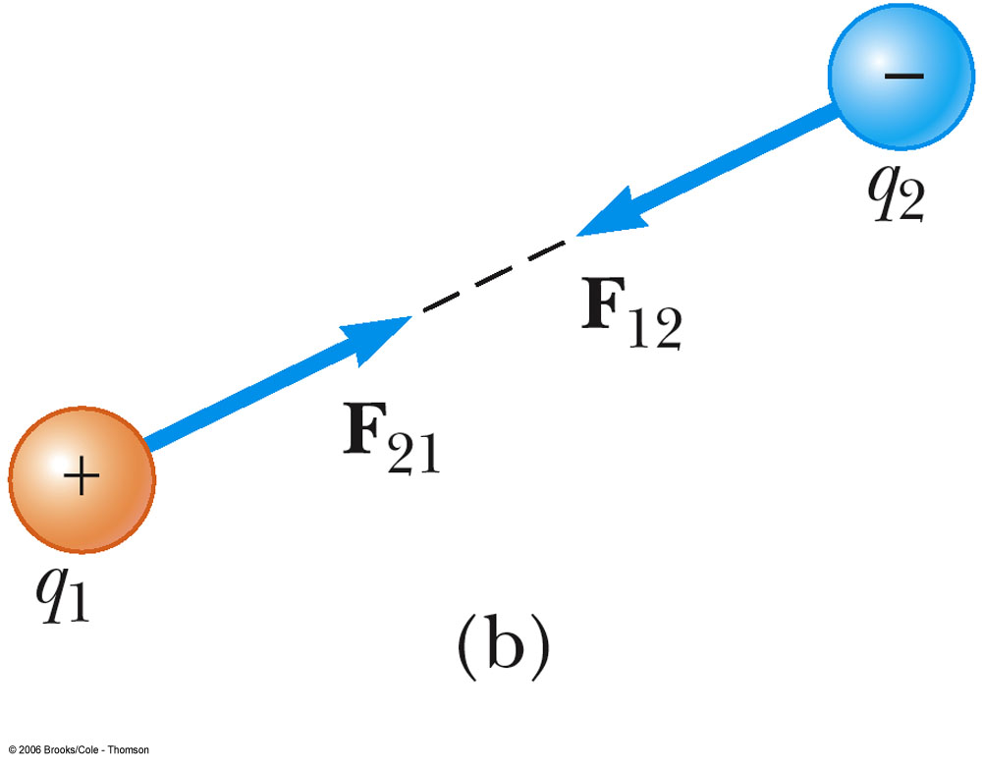
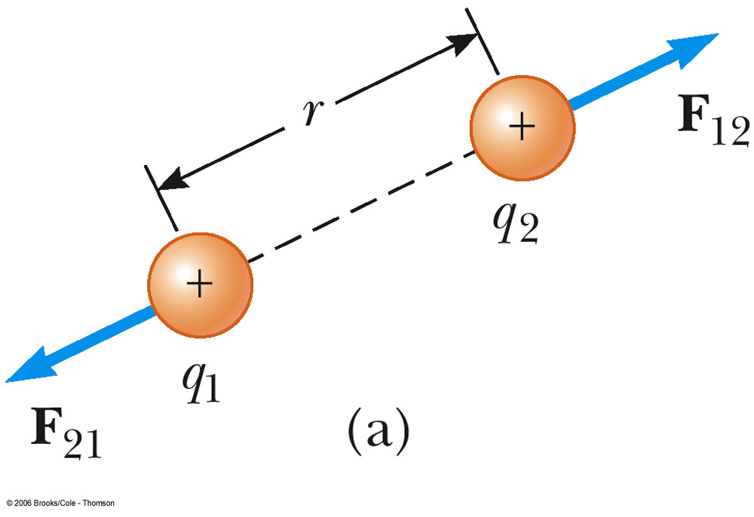
Coulomb’s Law
Where ĸ_{e} is an experimentally determined positive constant called the Coulomb constant, which has the value

Slide 15
Electric Forces
Electric forces are vector quantities
Electric force on q₁ is equal in magnitude and opposite in direction to the force on q₂
Electric force is exerted by one object on another object without physical contact between them – field force
The superposition principle applies: resultant force on any one charge equals the vector sum of the forces exerted by the other individual charges that are present

Slide 16
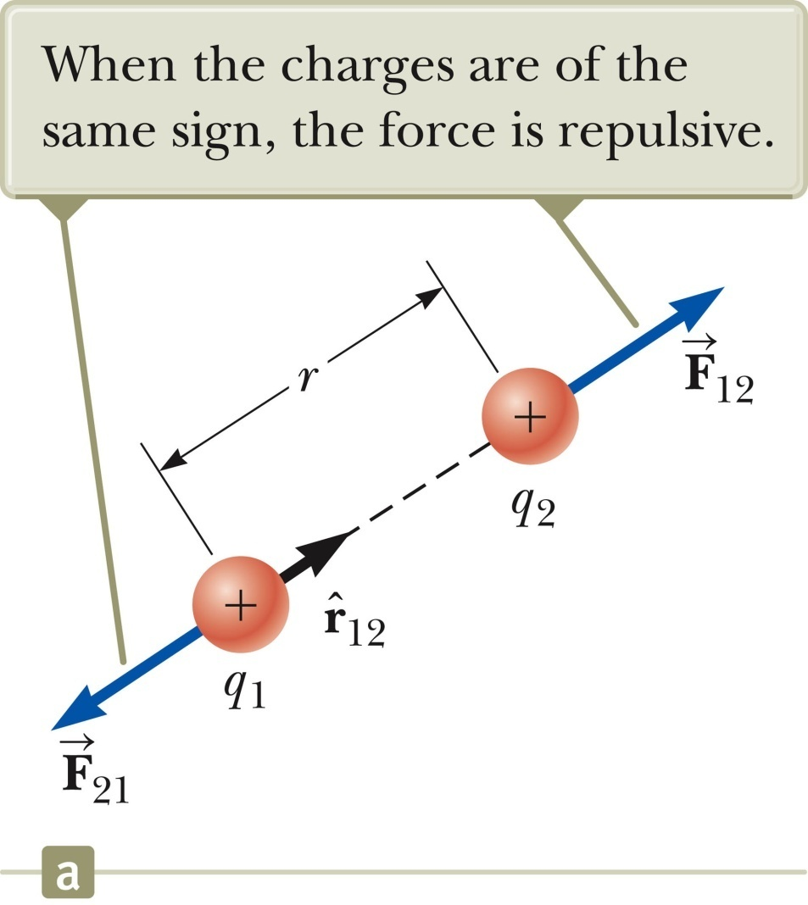
Vector Nature of Electric Forces
In vector form,
is a unit vector directed from q₁ to q_{2.}
The like charges produce a repulsive force between them.
Section 23.3

Slide 17
Vector Nature of Electrical Forces, cont.
Electrical forces obey Newton’s Third Law.
The force on q₁ is equal in magnitude and opposite in direction to the force on q₂
With like signs for the charges, the product q₁q₂ is positive and the force is repulsive.
Section 23.3

Slide 18
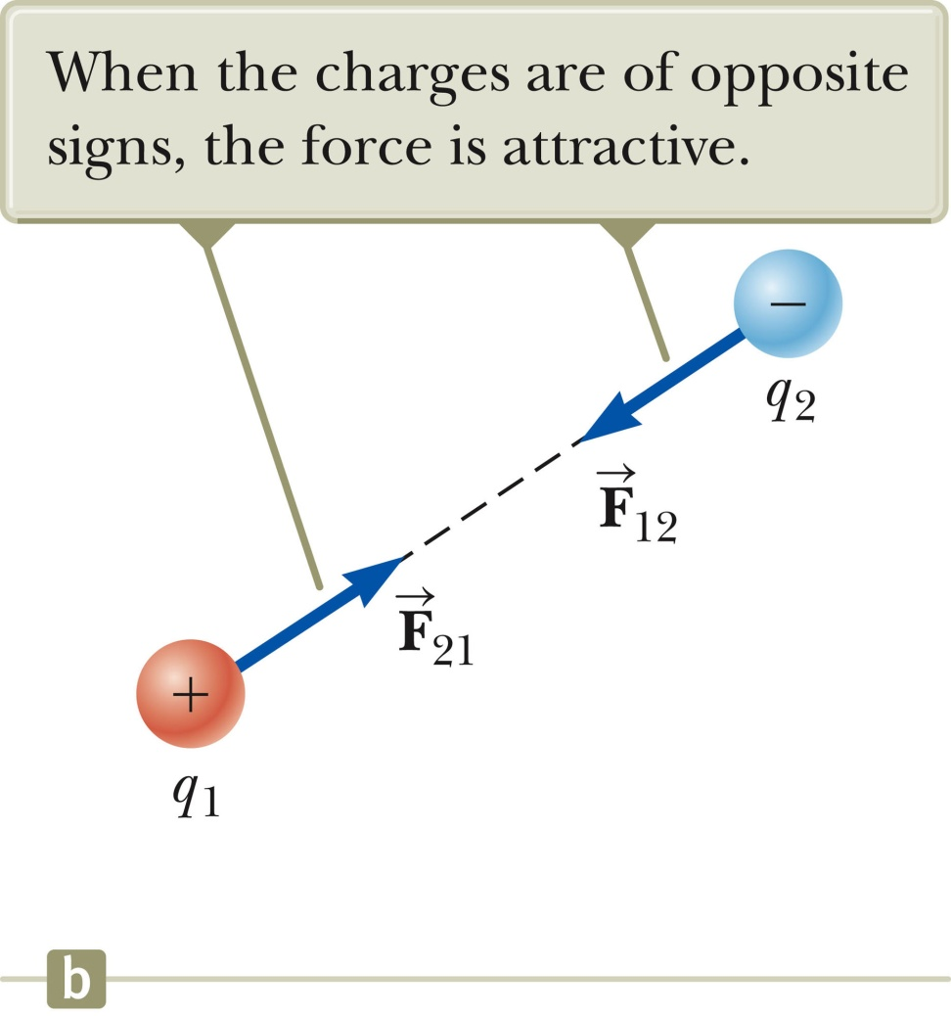
Vector Nature of Electrical Forces, 3
Two point charges are separated by a distance r.
The unlike charges produce an attractive force between them.
With unlike signs for the charges, the product q₁q₂ is negative and the force is attractive.
Section 23.3

Slide 19
Multiple Charges
The resultant force on any one charge equals the vector sum of the forces exerted by the other individual charges that are present.
Remember to add the forces as vectors.
The resultant force on q₁ is the vector sum of all the forces exerted on it by other charges.
For example, if four charges are present, the resultant force on one of these equals the vector sum of the forces exerted on it by each of the other charges.
Section 23.3

Slide 20
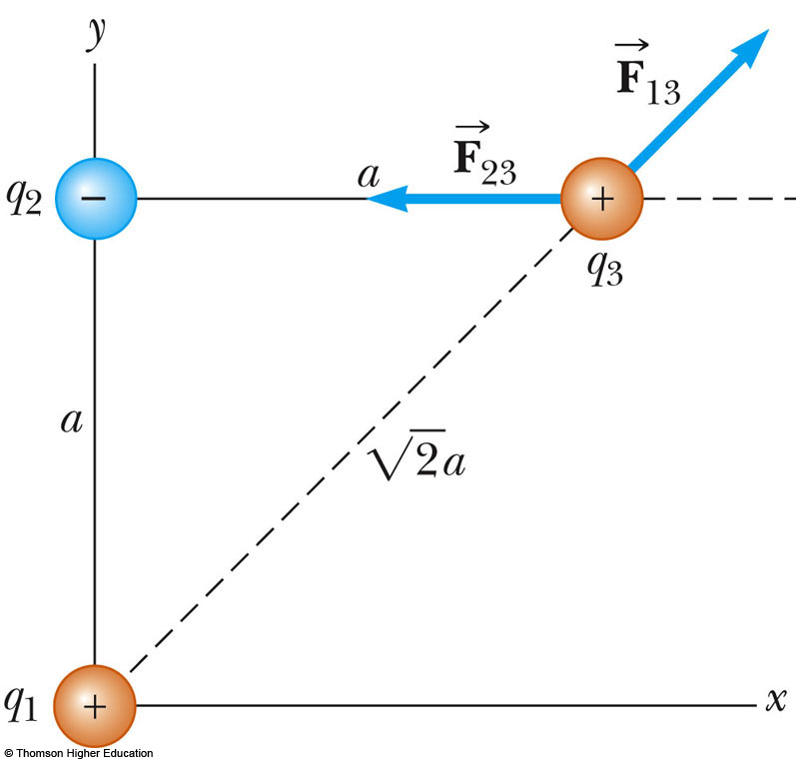
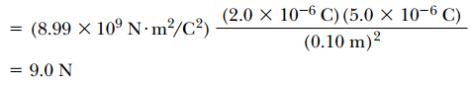
Problem: Superposition Principle
Consider three point charges located at the corners of a right triangle as shown in Figure.
Where ,
and m.
Find the resultant force exerted on q_{3.}
Solution:

Slide 21

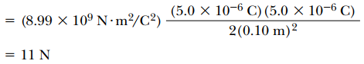
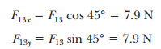
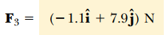
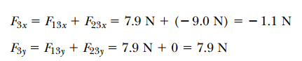
Problem: Superposition Principle
Solution:

Slide 22
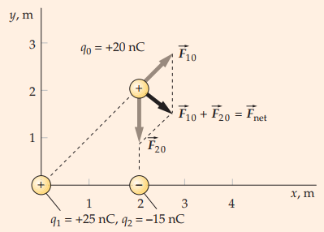
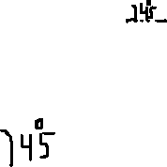
Practice Problem
Charge q₁ = +25 nC is at the origin, charge q₂ = -15 nC is on the axis at x = 2.0 m, and charge q₀ = +20 nC is at the point x = 2.0 m, y = 2.0 m as shown in Figure. Find the magnitude and direction of the resultant electric force on q₀.

Slide 23
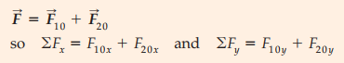
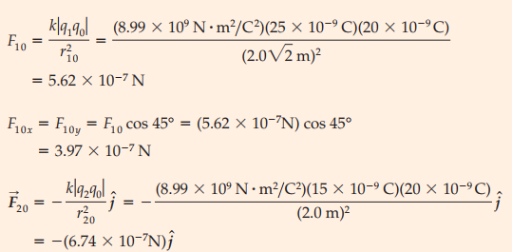
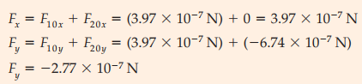
Practice Problem
Solution:

Slide 24
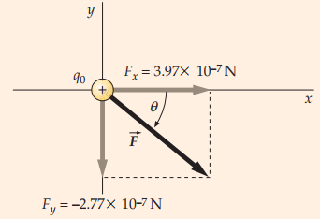
Practice Problem
Solution: Resultant Force diagram

Slide 25
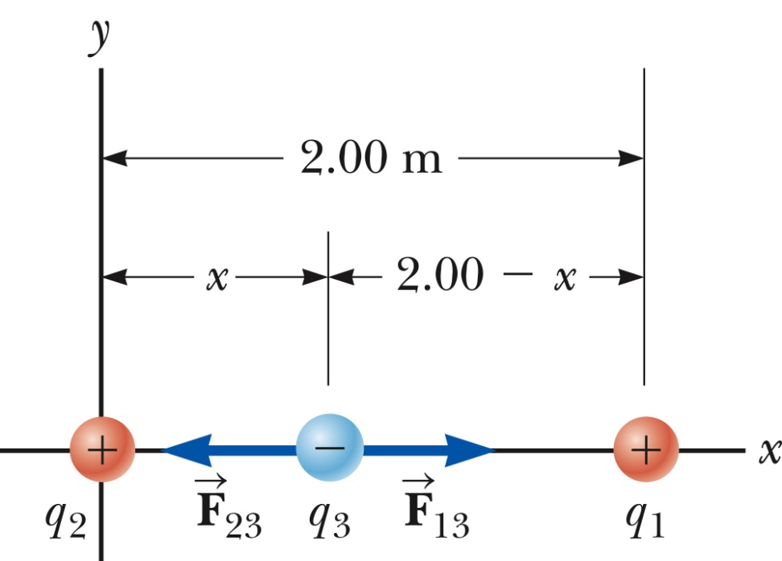
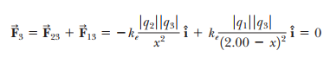
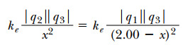
Problem: Where is the net force is zero?
Three point charges lie along the x axis as shown in Figure .
The positive charge q₁ =15.0 µC is at x =2.00 m, the positive charge q₂=6.00 µC is at the origin, and the net force acting on q₃ is zero.
What is the x coordinate of q₃?
Section 23.3

Slide 26
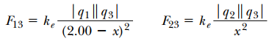
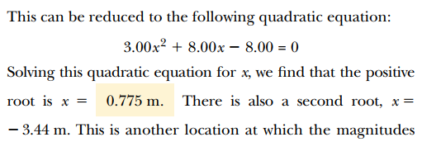
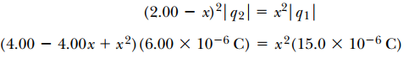
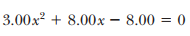
Problem: Where is the net force is zero?
What is the x coordinate of q₃?
Solution:

Slide 27
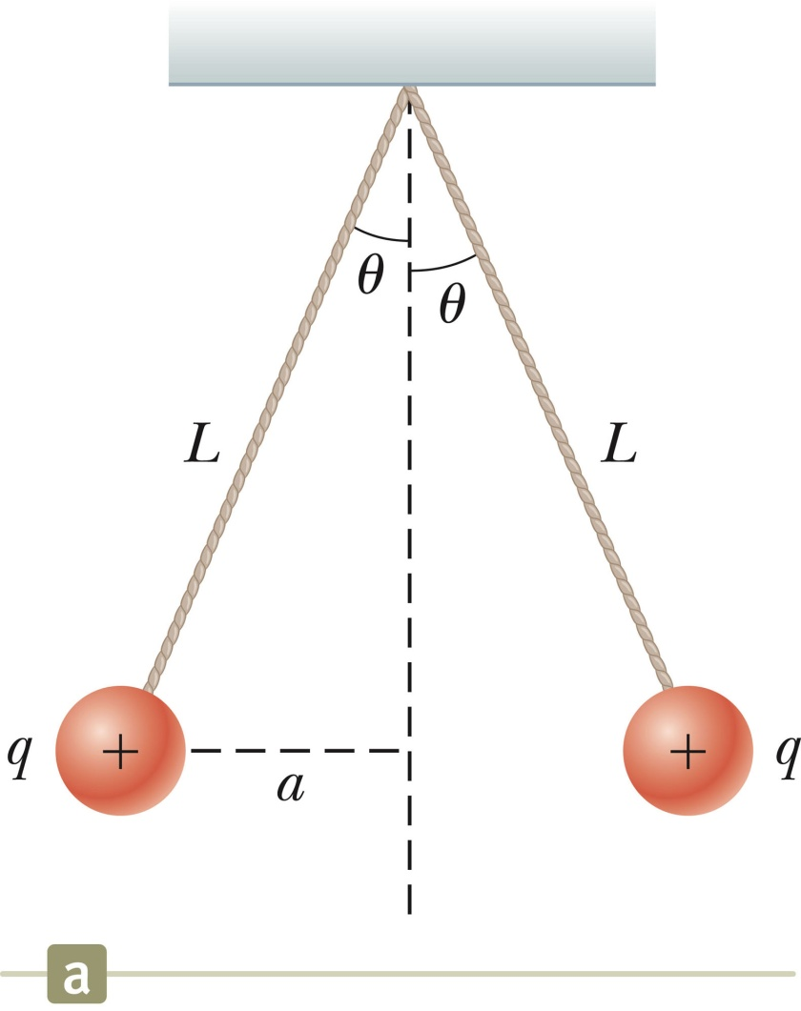
Problem : Find the charge on the spheres
Two identical small charged spheres, each having a mass of 3.0 × 10⁻² kg, hang in equilibrium as shown in Figure The length of each string is 0.15 m, and the angle θ is 5.0°
Find the magnitude of the charge on each sphere.
Section 23.3

Slide 28
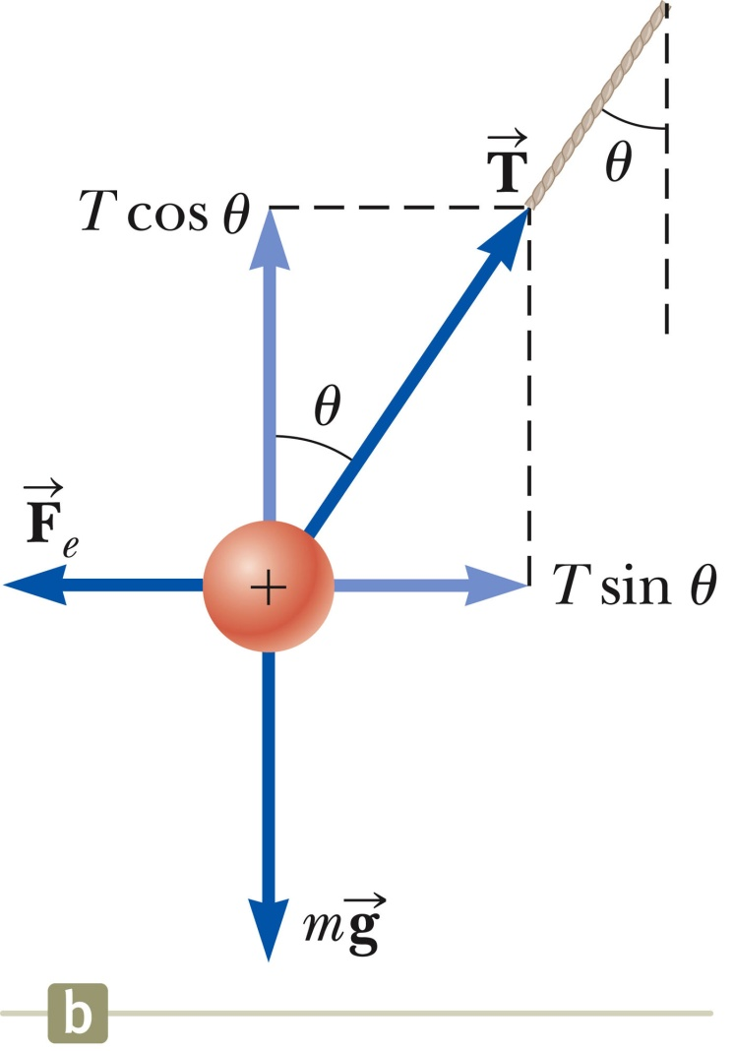
Free Body Diagram
Section 23.3

Slide 29
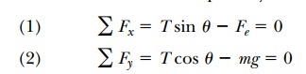
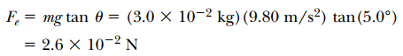
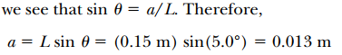
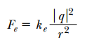
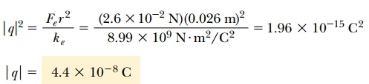
Free Body Diagram

Slide 30
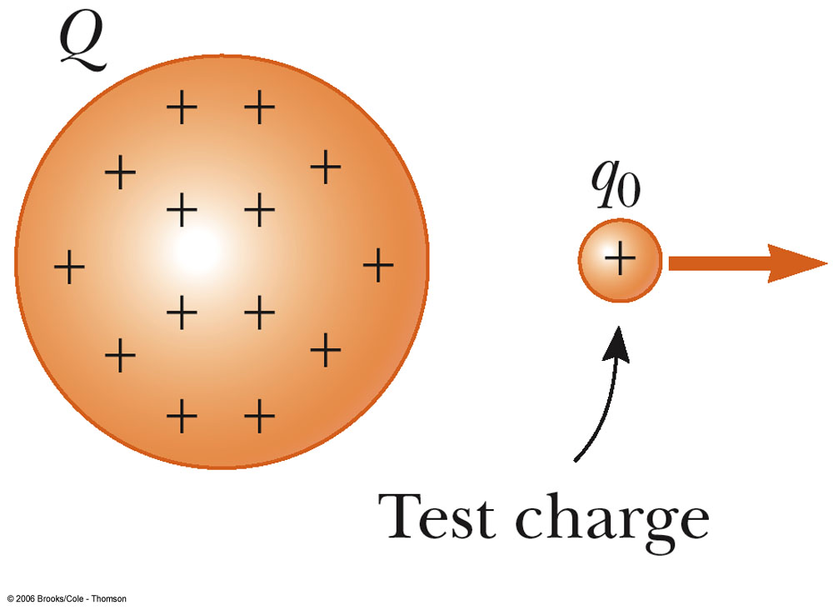
Electric Field
Electric field exists in the region of space around a charged object (source charge)
When another charged object q₀ (test charge) enters this electric field, the field exerts an electric force F on the test charge
Electric field:
SI units: N / C

Slide 31
Electric Field
The field is produced by some charge or charge distribution, separate from the test charge
The existence of an electric field is a property of the source charge; the presence of the test charge is not necessary for the field to exist
The test charge serves as a detector of the field

Slide 32
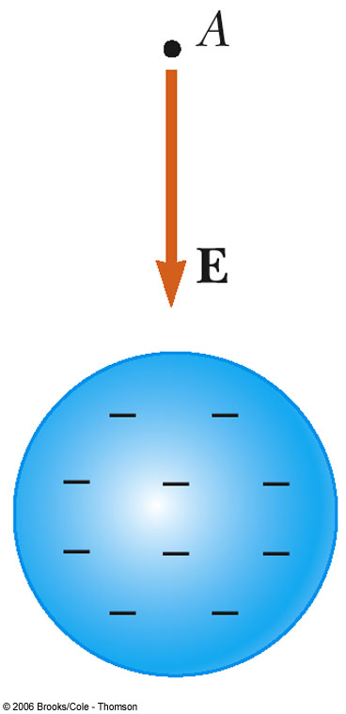
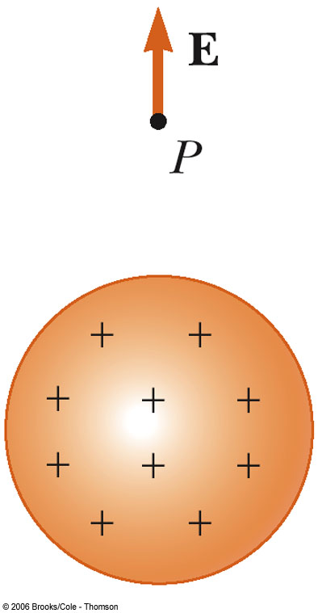
Direction of Electric Field
The direction of the vector of electric field is defined as the direction of the electric force that would be exerted on a small positive test charge placed at that point
The electric field produced by a negative charge is directed toward the charge (attraction)
The electric field produced by a positive charge is directed away from the charge (repulsion)

Slide 33
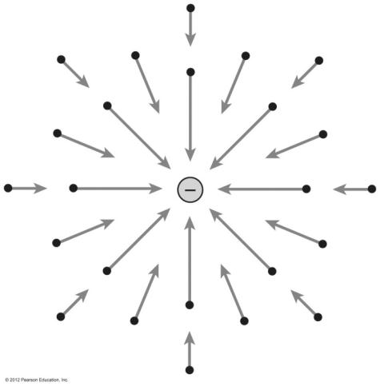
Relationship Between F and E
If q is positive, the force and the field are in the same direction; if q is negative, the force and the field are in opposite directions
Coulomb’s law, between the source and test point charges, can be expressed as
Then

Slide 34
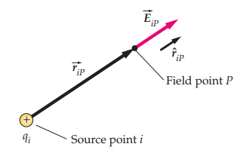
Electric Field, Vector Form
Remember Coulomb’s law, between the source and test charges, can be expressed as
Then, the electric field will be
Section 23.4

Slide 35


Superposition of Electric Fields
At any point P, the total electric field due to a group of source charges equals the vector sum of the electric fields of all the charges

Slide 36




Problem : Electric Field Due to Two Charges
Charges q₁ and q₂ are located on the x axis, at distances a and b, respectively, from the origin as shown in Figure.
(A) Find the components of the net electric field at the point P, which is on the y axis.

Slide 37

Problem : Electric Field Due to Two Charges
Charges q₁ and q₂ are located on the x axis, at distances a and b, respectively, from the origin as shown in Figure.
(A) Find the components of the net electric field at the point P, which is on the y axis.

Slide 38




Problem : Electric Field Due to Two Charges
Charges q₁ and q₂ are located on the x axis, at distances a and b, respectively, from the origin as shown in Figure.
(B) Evaluate the electric field at point P in the
special case that and a = b.

Slide 39

Problem : Electric Field Due to Two Charges
Charges q₁ and q₂ are located on the x axis, at distances a and b, respectively, from the origin as shown in Figure. (C) Find the electric field due to the electric dipole when point P is a distance y >> a from the origin.

Slide 40
Electric Field – Continuous Charge Distribution
The distances between charges in a group of charges may be much smaller than the distance between the group and a point of interest.
In this situation, the system of charges can be modeled as continuous.
The system of closely spaced charges is equivalent to a total charge that is continuously distributed along some line, over some surface, or throughout some volume.
Section 23.5

Slide 41


Continuous Charge Distributions
Figure shows an element of charge dq = ρ dV , Coulomb’s law states that the electric filed at point p is
The total field $\vec{E}$ at P is calculated by integrating this expression over the entire
charge distribution. That is,
Electric field due to a continuous charge distribution
The use of a continuous charge density to describe a large number of discrete charges is similar to the use of a continuous mass density to describe air, which actually consists of a large number of discrete atoms and molecules.

Slide 42
Charge Densities
Volume charge density:
when a charge is distributed evenly throughout a volume
ρ ≡ Q / V with units C/m³
Surface charge density:
when a charge is distributed evenly over a surface area
σ ≡ Q / A with units C/m²
Linear charge density:
when a charge is distributed along a line
λ ≡ Q / ℓ with units C/m
Section 23.5

Slide 43
Amount of Charge in a Small Volume
If the charge is non-uniformly distributed over a volume, surface, or line, the amount of charge, dq, is given by
For the volume: dq = ρ dV
For the surface: dq = σ dA
For the length element: dq = λ dℓ
Section 23.5

Slide 44
Solving Problems: Electric Forces and Electric Fields
Draw a diagram of the charges in the problem
Identify the charge of interest
Convert all units to SI
Apply Coulomb’s Law: for each charge, find the force on the charge of interest (determine the magnitude, the direction, and x- and y- components of the force)
Sum all the x- and y- components to obtain the x- and y-components of the resultant force (superposition principle)
Find the resultant force by using the Pythagorean theorem and trigonometry

Slide 45
Solving Problems with Electric Forces and Electric Fields
To calculate electric fields of point charges:
Find the electric field due to the individual charges
The direction is given by the direction of the force on a positive test charge
The superposition principle can be applied if a group of charges is present
Note: The electric field exists whether or not there is a test charge present

Slide 46

The Electric Field Due to a Charged Rod
A rod of length has a uniform positive charge per unit length and a total charge . Calculate the electric field at a point that is located along the long axis of the rod and a distance a from one end,

Slide 47




Example. Charged Ring
A ring of radius a carries a uniformly distributed positive total charge Q. Calculate the electric field due to the ring at a point P lying a distance x from its center along the central axis perpendicular to the plane of the ring.
By symmetry, E has only axial (x-) component.

Slide 48


Example. Charged Ring
A ring of radius a carries a uniformly distributed positive total charge Q. Calculate the electric field due to the ring at a point P lying a distance x from its center along the central axis perpendicular to the plane of the ring.
By symmetry, E has only axial (x-) component.
On axis of uniformly charged ring

Slide 49

Problem :The Electric Field of a Uniformly charged Disk
A disk of radius R has a uniform surface charge density “σ”.
Calculate the electric field at a point P that lies along the central perpendicular axis of the disk and a distance x from the center of the disk

Slide 50



Practice Problem:
Four point charges are at the corners of a square of side a as shown in the figure. Determine the magnitude and direction of the resultant electric force on q, with k_{e}, q, and a left in symbolic form.
$$\sqrt{2}a$$

Slide 51




Practice Problem
Three charged particles are located at the corners of an equilateral triangle as shown in Figure. Calculate the total electric force on the 7.00-μC charge.

Slide 52

Electric Field Lines
We can visualize the electric field by drawing a number of directed curved lines called electric field lines, to indicate both the magnitude and the direction of the field.
The electric field vector is tangent to the electric field line at each point.
The line has a direction that is the same as that of the electric field vector.
Electric field lines are also called lines of force because they show the direction of the electric force exerted on a positive test charge.
The more closely spaced the lines, the stronger the electric field.
The magnitude of the electric field is also called the electric field strength.
Section 23.6

Slide 53

Electric Field Lines, General
The density of lines through surface A is greater than through surface B.
The magnitude of the electric field is greater on surface A than B.
The lines at different locations point in different directions.
This indicates the field is non-uniform.
Section 23.6

Slide 54


Electric Field Line Patterns
For a positive point charge the lines will radiate outward equally in all directions
For a negative point charge the lines will point inward equally in all directions

Slide 55


Electric Field Line Patterns
An electric dipole consists of two equal and opposite point charges
The number of field lines leaving the positive charge equals the number of lines terminating on the negative charge
For two equal but like point charges, at a great distance from the charges, the field would be approximately that of a single charge of 2q (bulging out of the field lines between the charges – repulsion)

Slide 56

Electric Field Line Patterns
For these two unequal and unlike point charges, at a great distance from the charges, the field would be approximately that of a single charge of +q (two lines leave the +2q charge for each line that terminates on -q)

Slide 57
Rules for Drawing Electric Field Lines
For a group of charges, the lines must begin on positive charges and end on negative charges
In the case of an excess of charge, some lines will begin or end infinitely far away
The number of lines drawn leaving a positive charge or ending on a negative charge is proportional to the magnitude of the charge
No two field lines can cross each other

Slide 58

Motion of Charged Particles
When a charged particle is placed in an electric field, it experiences an electrical force.
If this is the only force on the particle, it must be the net force.
The net force will cause the particle to accelerate according to Newton’s second law.
The acceleration of the particle is
If the field is uniform, then the acceleration is constant.
Section 23.7

Slide 59




Problem (9): An Accelerating Positive Charge
A uniform electric field $\vec{E}$ is directed along the x axis between parallel plates of charge separated by a distance d as shown in Figure. A positive point charge q of mass m is released from rest at a point Ⓐ next to the positive plate and accelerates to a point Ⓑ next to the negative plate.
(A) Find the speed of the particle at Ⓑ by modeling it as a particle under constant acceleration.
Section 23.7

Slide 60




Example 23.10

Slide 61


Example 23.10

Slide 62


Example 23.10

Slide 63

Practice Problem:
A proton is projected in the positive x direction into a region of a uniform electric field $\vec{E}=−6.00×{10}^{5}\hat{i}$ N/C at t 0. The proton travels 7.00 cm as it comes to rest. Determine (a) the acceleration of the proton, (b) its initial speed, and (c) the time interval over which the proton comes to rest

Slide 64

Practice Problem:
Figure shows the electric field lines for two charged particles separated by a small distance. (a) Determine the ratio q₁/q₂. (b) What are the signs of q₁ and q₂?

Slide 65

Practice Problem:
A uniformly charged insulating rod of length 14.0 cm is bent into the shape of a semicircle as shown in Figure. The rod has a total charge of -7.50 μC. Find the
magnitude and direction of the electric field at O, the center of the semicircle.

Slide 66

Practice Problem:
Two identical particles, each having charge +q, are fixed in space and separated by a distance d. A third particle with charge -Q is free to move and lies initially at rest on the perpendicular bisector of the two fixed charges a distance x from the midpoint between the two fixed charges (Fig. P23.10). (a) Show that if x is small compared with d, the motion of -Q is simple harmonic along the perpendicular bisector. Determine the period of that motion. (b) How fast will the charge -Q be moving when it is at the midpoint between the two fixed charges if initially it is released at a distance a << d from the midpoint?

Slide 67


Electric Flux
The mathematical quantity that corresponds to the number of field lines penetrating a surface is called the electric flux Ф_{E.}
For a surface perpendicular to $\vec{E}$ the electric flux is the product of the magnitude of E the field and the area A: Φ_{E} = EA
Units: N · m² / C

Slide 68


Electric Flux, General Area
The electric flux is proportional to the number of electric field lines penetrating some surface.
The field lines may make some angle θ with the perpendicular to the surface.
Where θ is the angle between $\vec{E}$ and the unit vector $\hat{n}$ that is normal to the surface
Then Φ_{E} = $\vec{E}. \hat{n}A$= EA cos θ
Section 24.1

Slide 69
Electric Flux, Interpreting the Equation
The flux is a maximum when the surface is perpendicular to the field.
θ = 0°
The flux is zero when the surface is parallel to the field.
θ = 90°
If the field varies over the surface, Φ = EA cos θ is valid for only a small element of the area.
Section 24.1

Slide 70





Electric Flux through open surface
Figure shows a curved surface over which $\vec{E}$ may vary. If the area $∆A_{i}$ of the surface element that we choose is small enough, it can be modeled as a plane, and the variation of the electric field across the element can be neglected. The flux of the electric field through this element is
Summing the contributions of all elements gives an approximation to the total flux through the surface:
If the area of each element approaches zero, the number of elements approaches infinity and the sum is replaced by an integral. Therefore, the general definition of electric flux is

Slide 71



Flux of Electric Field (Closed Surface)
On a closed surface we are interested in the electric flux through the surface, and by convention, we always choose the unit vector $\vec{n}$ to be out of the surface at each point. The integral over a closed surface is indicated by the symbol $∮$.
The total or net flux through a closed surface is therefore written

Slide 72





Summary of Electric Flux
A flat surface is represented by a vector
where A = area of surface and
Electric flux through flat surface A :
[ Φ ] = N m² / C.
E↑, Φ↑
Open surface: can get from 1 side to the other w/o crossing surface.
Direction of A ambiguous.
A↓, Φ↓
Closed surface: can’t get from 1 side to the other w/o crossing surface.
A defined to point outward.

Slide 73

Gauss’s Law – General
A positive point charge, q, is located at the center of a sphere of radius r.
The magnitude of the electric field everywhere on the surface of the sphere is E = k_{e}q / r²
The field lines are directed radially outward and are perpendicular to the surface at every point.
This will be the net flux through the gaussian surface, the sphere of radius r.
We know E = k_{e}q/r² and A_{sphere} = 4πr²,
Section 24.2

Slide 74


Gauss’ Law
Gauss’ Law: The net outward flux through any closed surface equals the net charge inside the surface divided by $ε_{0}$.
Where $\vec{E}$ represents the electric field at any point on the surface and q_{in} in represents the net charge inside the surface.
ε_{o} = 8.85 x 10⁻¹² C²/Nm² : permittivity of free space
The area in Φ is an imaginary Gaussian surface (does not have to coincide with the surface of a physical object)

Slide 75
CONCEPTUAL EXAMPLE 2 4 . 2 Flux Due to a Point Charge
A spherical gaussian surface surrounds a point charge q. Describe what happens to the total flux through the surface if (A) the charge is tripled, (B) the radius of the sphere is doubled, (C) the surface is changed to a cube, and (D) the charge is moved to another location inside the surface.
(A) The flux through the surface is tripled because flux is proportional to the amount of charge inside the surface.
(B) The flux does not change because all electric field lines from the charge pass through the sphere, regardless of its radius.
(C) The flux does not change when the shape of the gaussian surface changes because all electric field lines from the charge pass through the surface, regardless of its shape.
(D) The flux does not change when the charge is moved to another location inside that surface because Gauss’s law refers to the total charge enclosed, regardless of where the charge is located inside the surface.

Slide 76




EXAMPLE 2 4 . 3: Application’s of Gauss’s law
An insulating solid sphere of radius a has a uniform volume charge density ρ and carries a total positive charge Q.
(A) Calculate the magnitude of the electric field at a point outside the sphere.

Slide 77







EXAMPLE 2 4 . 3: Application’s of Gauss’s law
An insulating solid sphere of radius a has a uniform volume charge density ρ and carries a total positive charge Q.
(B) Find the magnitude of the electric field at a point inside the sphere.
Calculate q_{in} by using q_{in}= ρ$V′$ :

Slide 78



EXAMPLE 2 4 . 3: Application’s of Gauss’s law
An insulating solid sphere of radius a has a uniform volume charge density ρ and carries a total positive charge Q.
What If? Suppose the radial position r = a is approached from inside the sphere
and from outside. Do we obtain the same value of the electric field from both directions?

Slide 79


Example . Uniformly Charged Sphere
A charge Q is spreaded uniformily throughout a sphere of radius R.
Find the electric field at all points, first inside and then outside the sphere.
→
∴
True for arbitrary spherical ρ(r).

Slide 80


Example: Hollow Spherical Shell
A thin, hollow spherical shell of radius R contains a total charge of Q. distributed uniformly over its surface.
Find the electric field both inside and outside the sphere.
Reflection symmetry → E is radial.
∴
Contributions from A & B cancel.

Slide 81

Electric Field of a Charged Thin Spherical Shell
The calculation of the field outside the shell is identical to that of a point charge
The electric field inside the shell is zero

Slide 82


Example 21.4. Infinite Line of Charge
Use Gauss’ law to find the electric field of an infinite line charge carrying charge density λ in C/m.
(radial field)
No flux thru ends
→
∴
c.f. Eg. 20.7
True outside arbitrary radial ρ(r⊥).

Slide 83


Electric Field of a Nonconducting Plane Sheet of Charge
The uniform field must be perpendicular to the sheet and directed either toward or away from the sheet
Use a cylindrical Gaussian surface
The flux through the ends is EA and there is no field through the curved part of the surface
Surface charge density σ = Q / A

Slide 84

Parallel Plate Capacitor
The device consists of plates of equal positive and negative charge
The total electric field between the plates is given by
The field outside the plates is zero

Slide 85
Summary
Electric flux is the amount of electric field passing through a closed surface.
Flux is positive when electric field is outward, and negative when electric field is inward through the closed surface.
Gauss’ Law states that the electric flux is proportional to the net charge enclosed by the surface, and the constant of proportionality is ε₀. In symbols, it is
There are three geometries we typically deal with:
Geometry | Charge Density | Gaussian surface | Electric field
Linear | λ = q/L | Cylindrical, with axis along line of charge
Sheet or Plane | σ = q/A | Cylindrical, with axis along E.
Spherical | ρ = q/V | Spherical, with center on center of sphere
Line of Charge
Conducting
Nonconducting
r ≥ R
r < R

Slide 86
Summary, cont’d
The electric field is zero inside a conductor.
The electric field is zero inside a cavity within a conductor, unless there is a charge inside that is not in contact with the walls.
The electric field at the surface of a conductor is always perpendicular to that surface.
Note, none of this is true for insulators.

